Slide 1

DATA ANALYSIS ON FLATS PRICES IN HYDERABAD

Slide 2


Team Size : 2 Members Name : Divya Pillala B.Tech –(IT) Graduated From SVS College(JNTU University) Name : Swetha Motapothula B.Tech –( CSE) Graduated From BITS COLLEGE-(JNTU University)

Slide 3
Agenda:
Business Problem and Use Case Domain Understanding
Objective of the Project
Web Scrapping-Details(Websites , Processor we followed)
Summary of the Data
Exploratory Data Analysis:
Data Cleaning
Univariate Analysis
Bivariate Analysis
Conclusion
Your Experience/Challenges working on Web Scrapping-Data Analysis Project

Slide 4

MODULES AND LIBRARIES
WEB SCRIPTING
Python
Beautiful Soup
Requests
DATA CLEANING
Regular Expression really helped well in manipulating the data as per requirements
NumPy and Pandas
VISUALIZATION
Matplotlib
Sea born

Slide 5

Objective Of The Project
WEB SITE:PROPERTY WALA-FLAT
The main objective of this project is to identify the best Flat Prices in Hyderabad based on the Area, Prices , Square Feet and Square Feet Price.

Slide 6
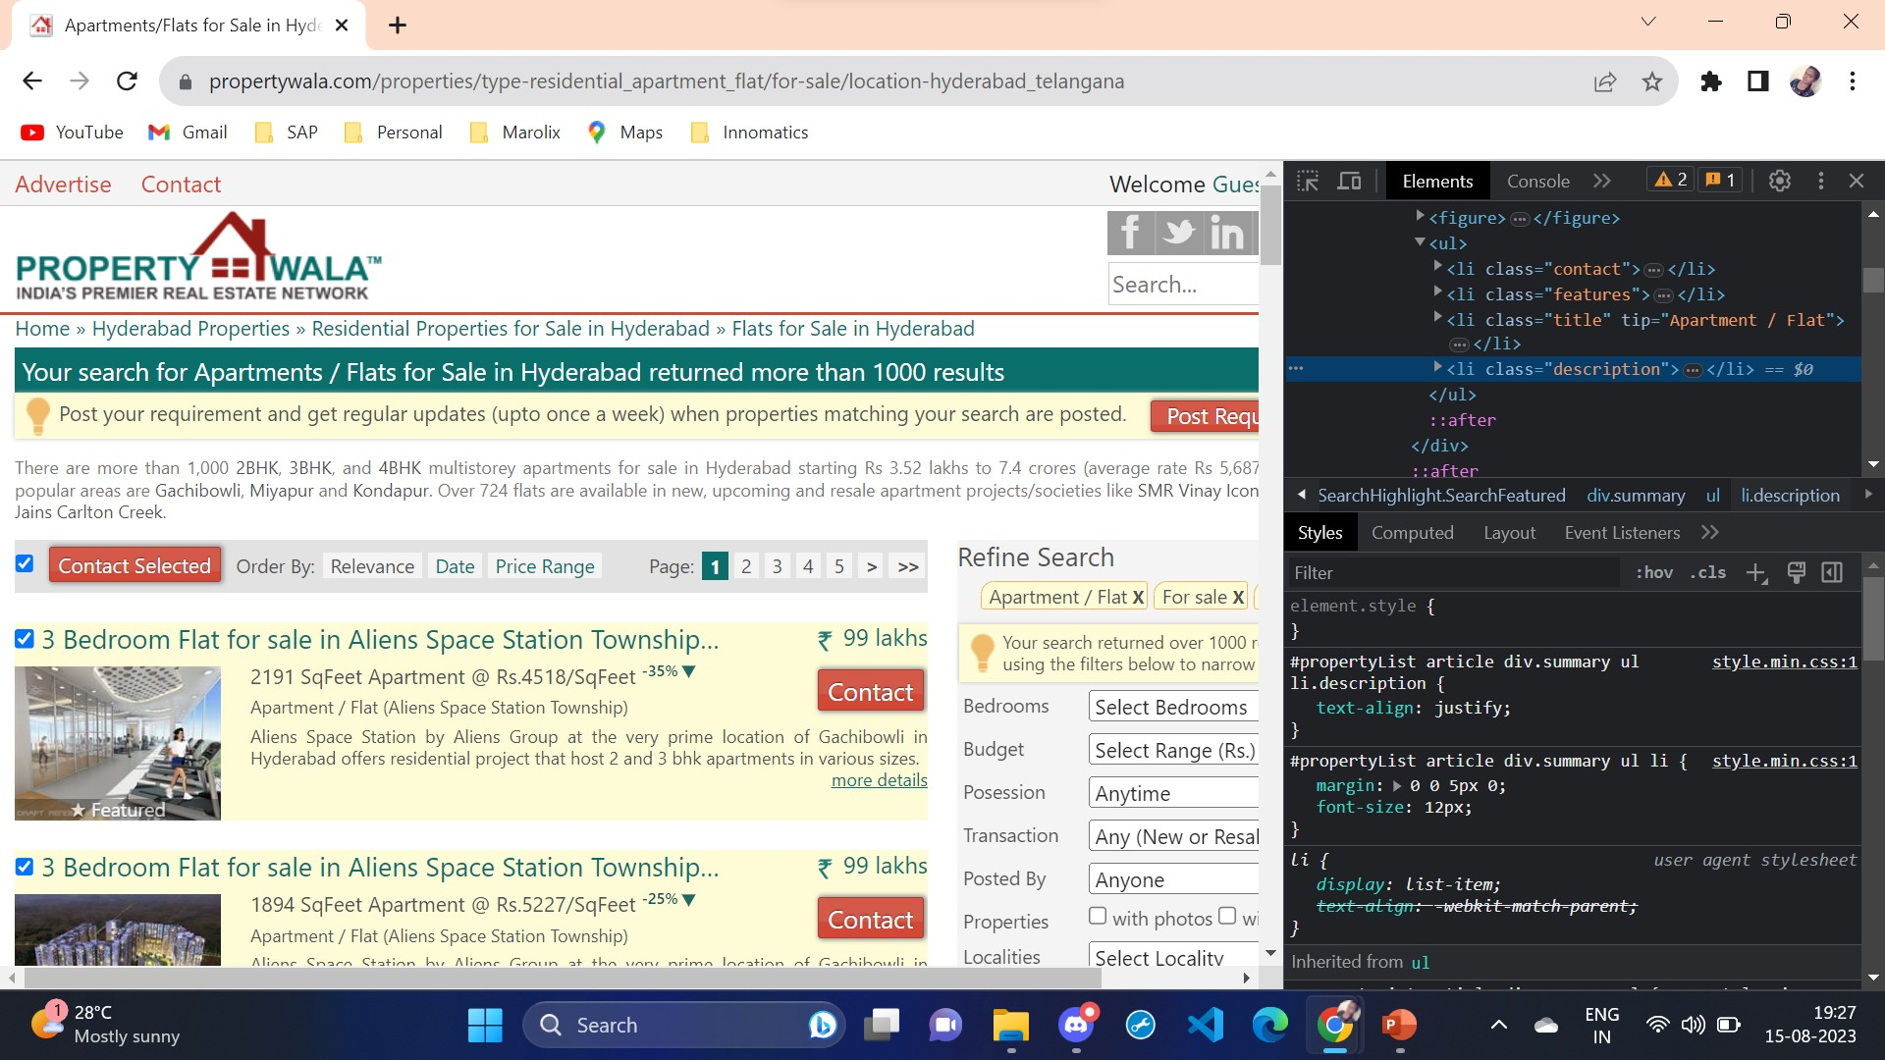
DATA COLLECTION
Here , we have used this website to get the data.
Then we get the data and perform exploratory data analysis.

Slide 7
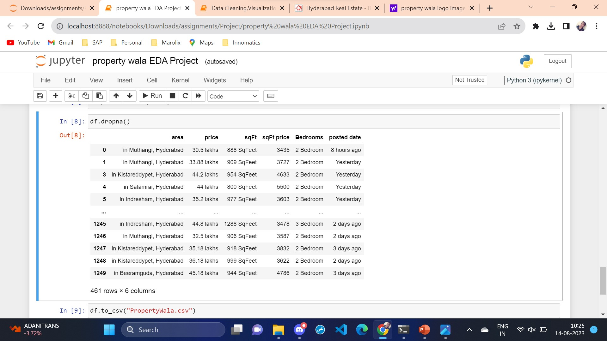
DATASET AFTER SCRAPPING: FEAUTURES: Areas Price Square feet Square feet Prize Bed rooms Posted date Price cat

Slide 8
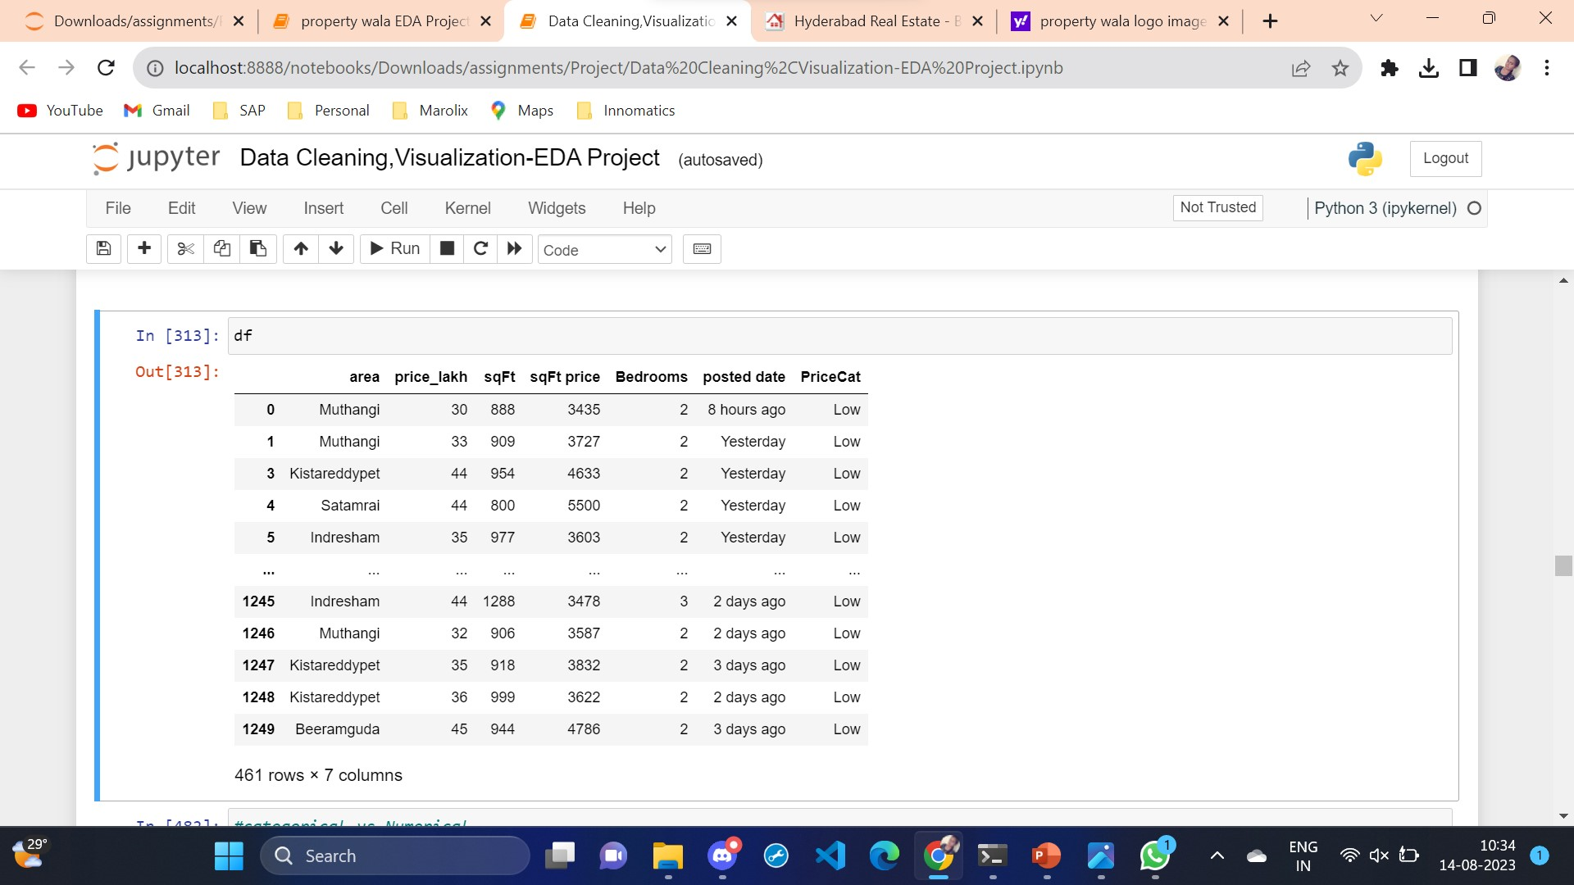
DATA CLEANING
Identifying Null values.
Identifying Missing values.
Treating row and columns with null values and missing values.
Extracting required data from columns to create another column using Regular expression.
Treating columns and converting required columns from objects to int or float data types.

Slide 9
DATA VISUALIZATION
UNIVARIATE ANALYSIS:
Univariate to analysis is done on each variable or feature in the dataset.
Categorical
Numerical
BIVARIATE ANALYSIS:
It is performed on two features
Categorical vs Categorical(Count plot,Heat map,Bar chat)
Numerical vs Categorical(Box plot,Histogram,Pie chat)
Numerical vs Numerical(Scatterplot,Heat map,Box plot)

Slide 10
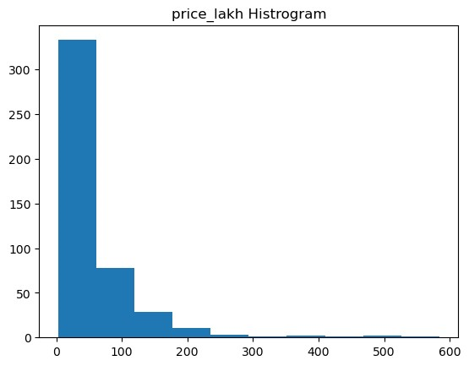
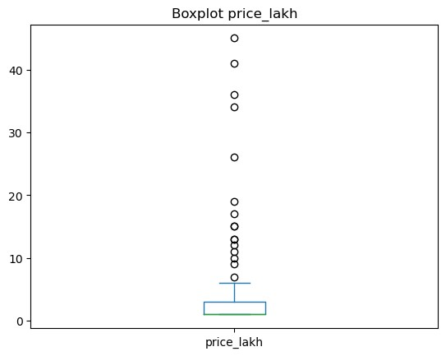
Price Analysis
In the above histogram plot the highest price is available in 600 prices.the maximum distribution in between 0-50 prices.
In the above box plot we can see that outlier are visualized in the price.

Slide 11
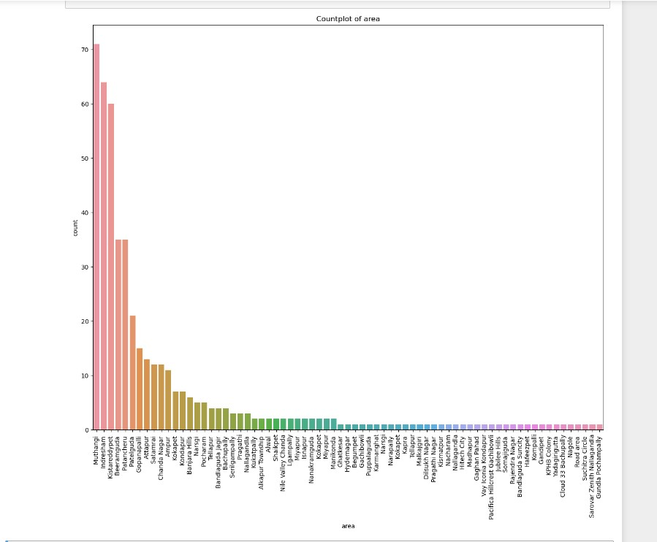
Count Plot Area Analysis
The count plot area shows that there are more areas 70 above.
Muthangi has the highest count of area,while Gudla Pochampally is lowest.

Slide 12
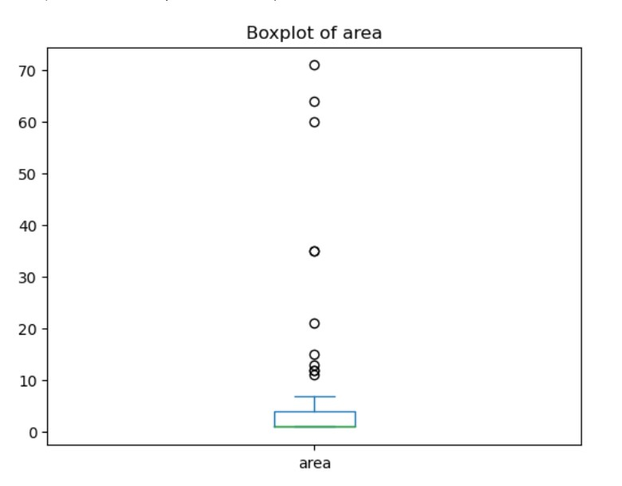
Box plot area analysis
The area with area 10 and above are visualized in boxplot as outliers.

Slide 13
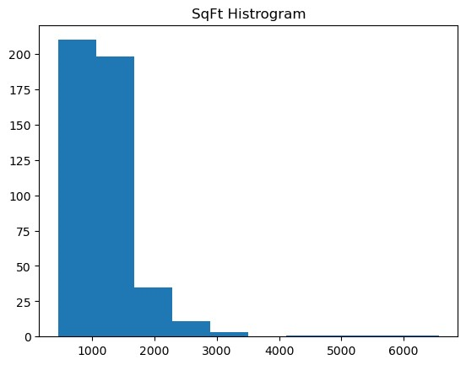
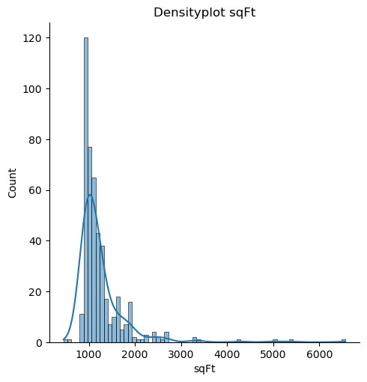
Square feet analysis
In below Density plot most of the flats are in 1000Square feets.
In below hist plot most of the flats are in 500-1500square feets.

Slide 14
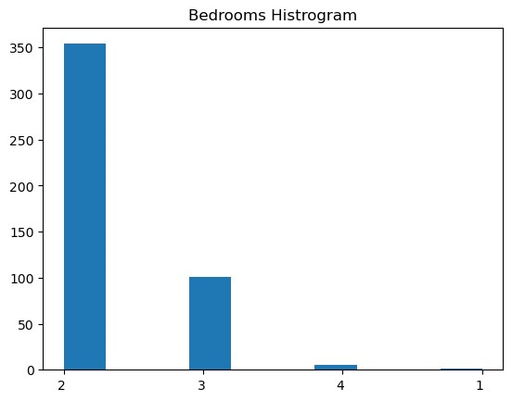
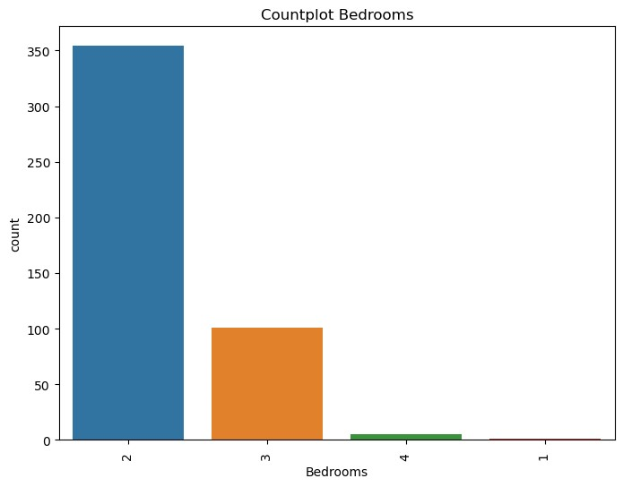
Bedroom analysis
This hist plot shows that there 2Bedrooms are high 1Bedroom are low.
In the above count plot shows that the 2Bedrooms are high 1Bedroom are low.

Slide 15
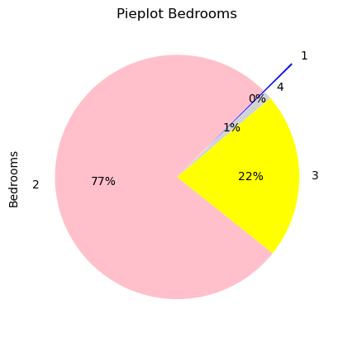
Pie Plot Bedrooms Analysis
This pie chat shows percentage of bedrooms.
2Bedrooms has the highest availability of areas, accounting for 77%.
1Bedrooms is the lowest bedrooms in area comprising only 0%.
3Bedrooms is an average availability of area at 22%.

Slide 16
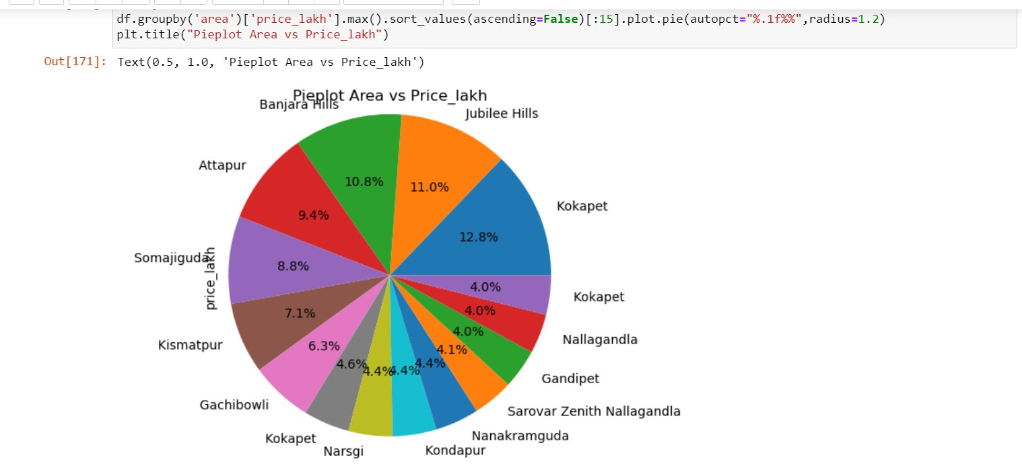
CATEGORICAL VS NUMERICAL
This pie chat shows percentage of price on top 15 areas.
The price of the area in jubilee hills is high.

Slide 17
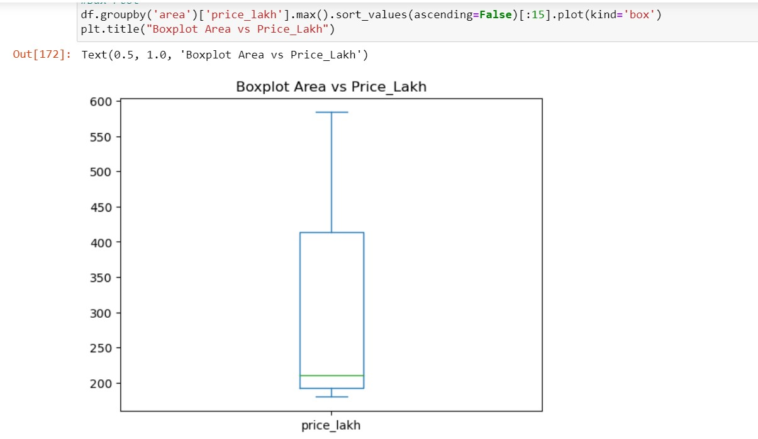
CATEGORICAL VS NUMERICAL
In the box plot there is no outliers between Area vs Price.

Slide 18
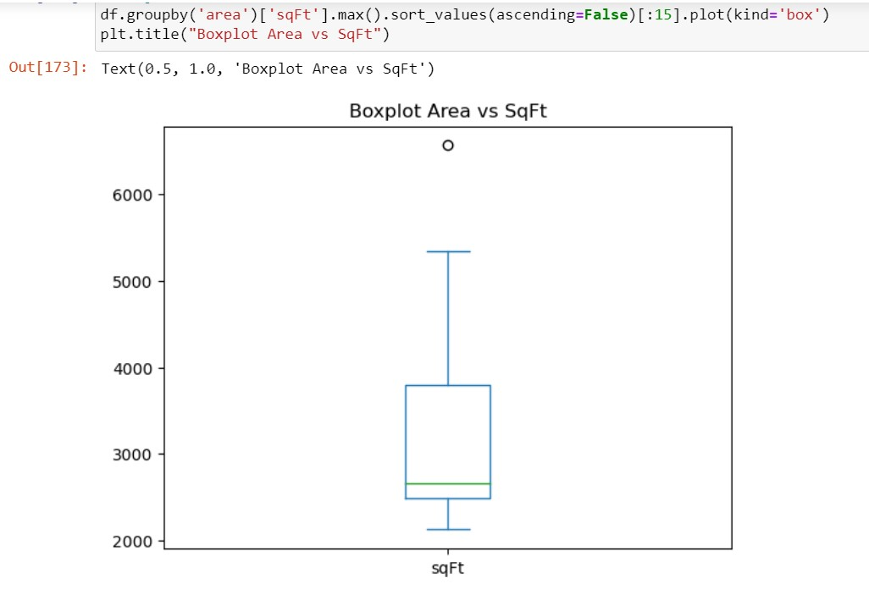
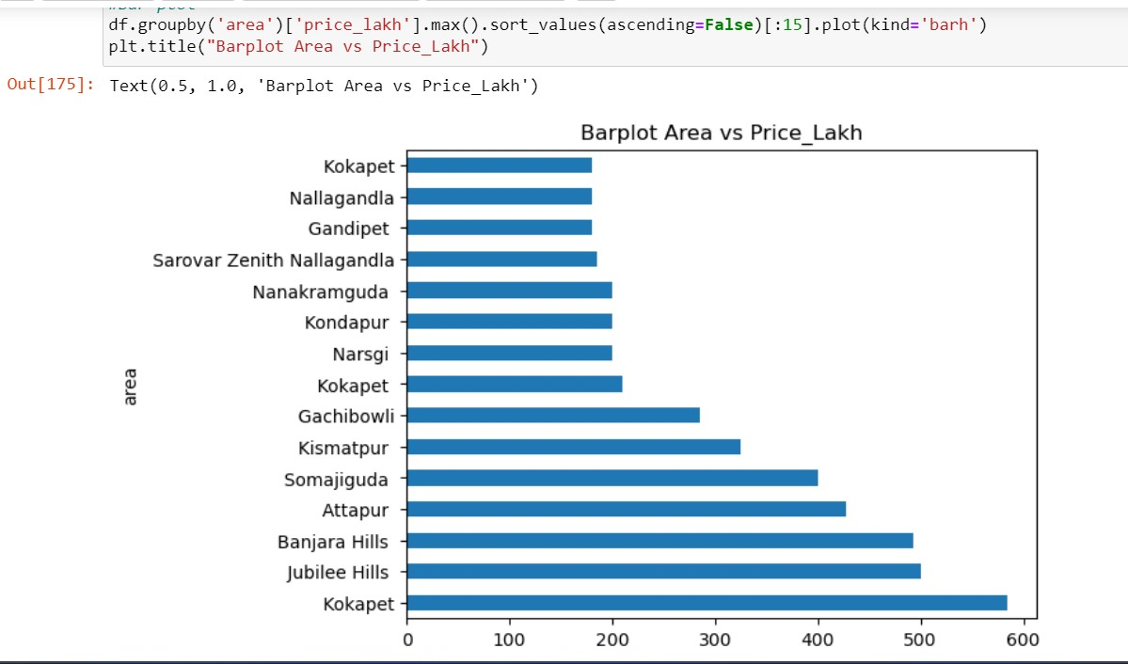
CATEGORICAL VS NUMERICAL
The graph depicts that the area consists of one outliers is visualized.
This Bar plot shows top 15 area of prices can know that the price of the Kokapet area is high.

Slide 19
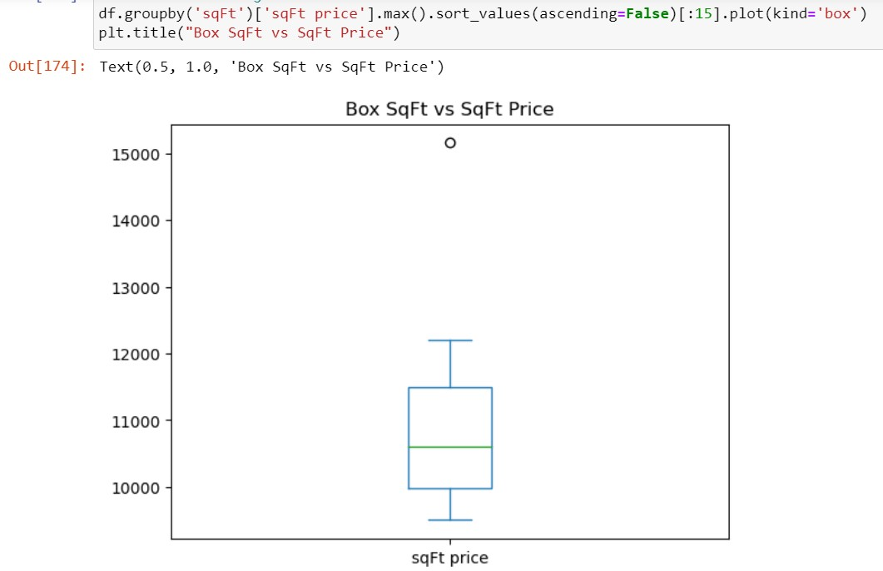
NUMERICAL VS NUMERICAL
The graph depicts that the price of the consists of one outliers is visualized.

Slide 20
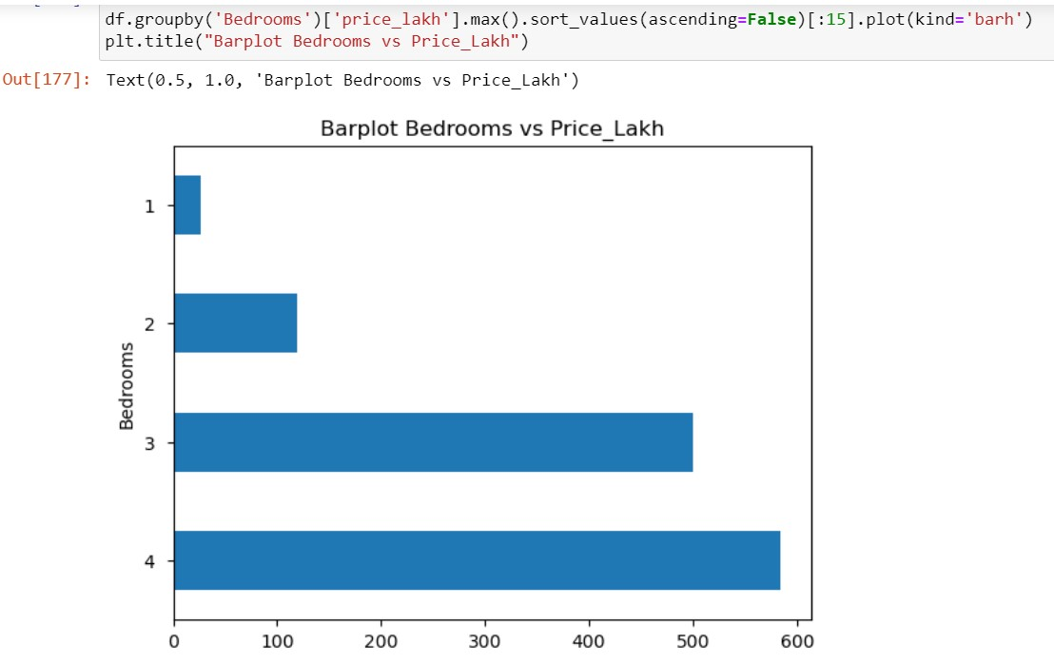
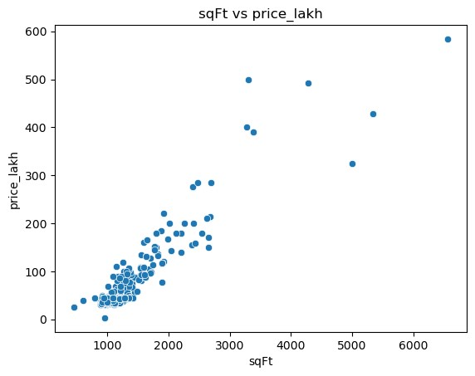
NUMERICAL VS NUMERICAL
Scatter plot shows that most flats sqft is about and the price is between 100 to 300.
Tha above bar plot shows that 4bedrooms consist of more price.
1Bedrooms consist of less price.

Slide 21
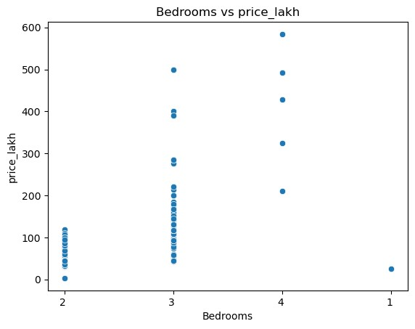
SCATTER PLOT
Scatter plot shows that 3Bedrooms and 4Bedrooms are more and the price is up to 600.

Slide 22
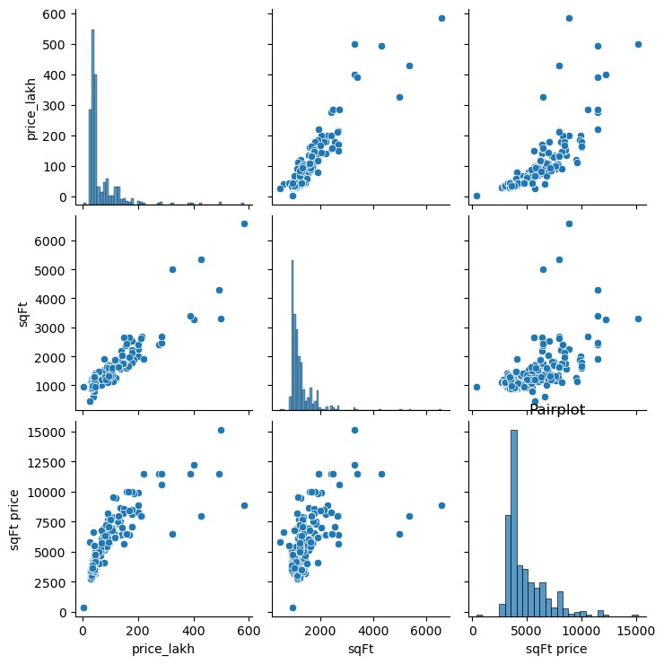
PAIR PLOT
From the Pair Plot we can describe completely about price , square feet , square feet price with related to area.

Slide 23
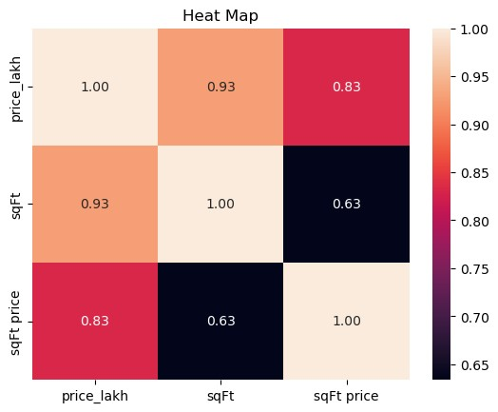
HEAT MAP
In my dataset there the diagonal line shows strong relation.
There is no significant relationship between columns.
All are positive , so we can analyze that there are few points where the correlation between two columns are paritially in relation.
Heat map represents the correlation between Price, Square feet and Square feet price.

Slide 24
CHALLEGES FACES
Due to dynamic Website , the length of data frame is changing when we run the code repeatedly.
Every page has null values and data missing even though it is present in webpage.
I had gone through each page and checked for any data present but is missing when extracted and added them manually using python.
If I had to replace more data I just have not done any operation on that particular column .
The type of visualization is mainly depends on categorical and numerical data,so according to data type we need to take suitable graph.

Slide 25
CONCLUSION
I here by conclude by sharing my observations in this particular project .
Here my problem statement was Real estates flat using prices in different areas.
Muthungi consist of more no of flats and Gudla Pochampally consist of less no of flats.
The price of flats in Kokapet are more higher than other areas where as Nallagandla area consists of less cost in areas.

Slide 26

THANK YOU

